Slide 1


SBI Summer School:
Inference

Slide 2
What is a model?
“The aim of science, of every science, is to describe and explain the events that occur in the world. If the descriptions and explanations we come to are adequate, they will allow not only to understand the how and why of the old things, but also to predict the happening of new ones.”
-- Fum, Missier, Stocco (2007)
Models are used when we are investigating a system that is too complex to deal with directly.
They are (necessarily) simplifications of the system

Slide 3
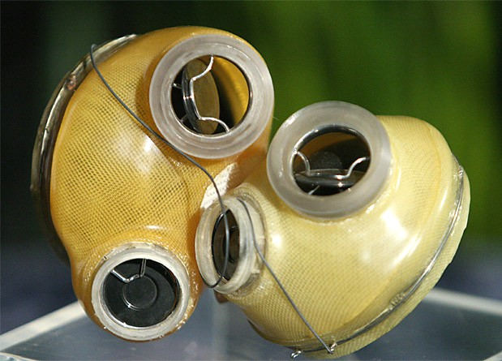
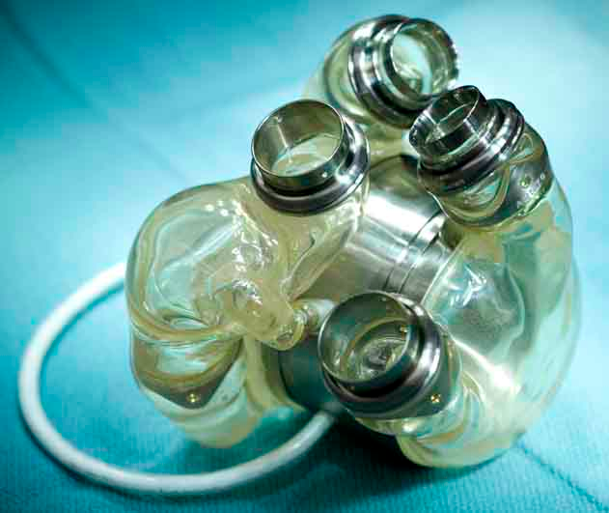
When “Idealized” becomes Reality
First artificial heart in a dog, by Vladimir Demikhov in 1937
First artificial human heart designed by Robert Jarvik and Willem Johan Kolff
Implanted in a patient Barney Clark in 1982
Patient survived with implant for 112 days
Jarvik-7: the first artificial heart
AbioCor Total Replacement (2009)
Notes:
You might have heard of Demikhov from other studies. Namely, he is known for his transplantation of a dog’s head, resulting in a two-headed dog in the 1950s.

Slide 4

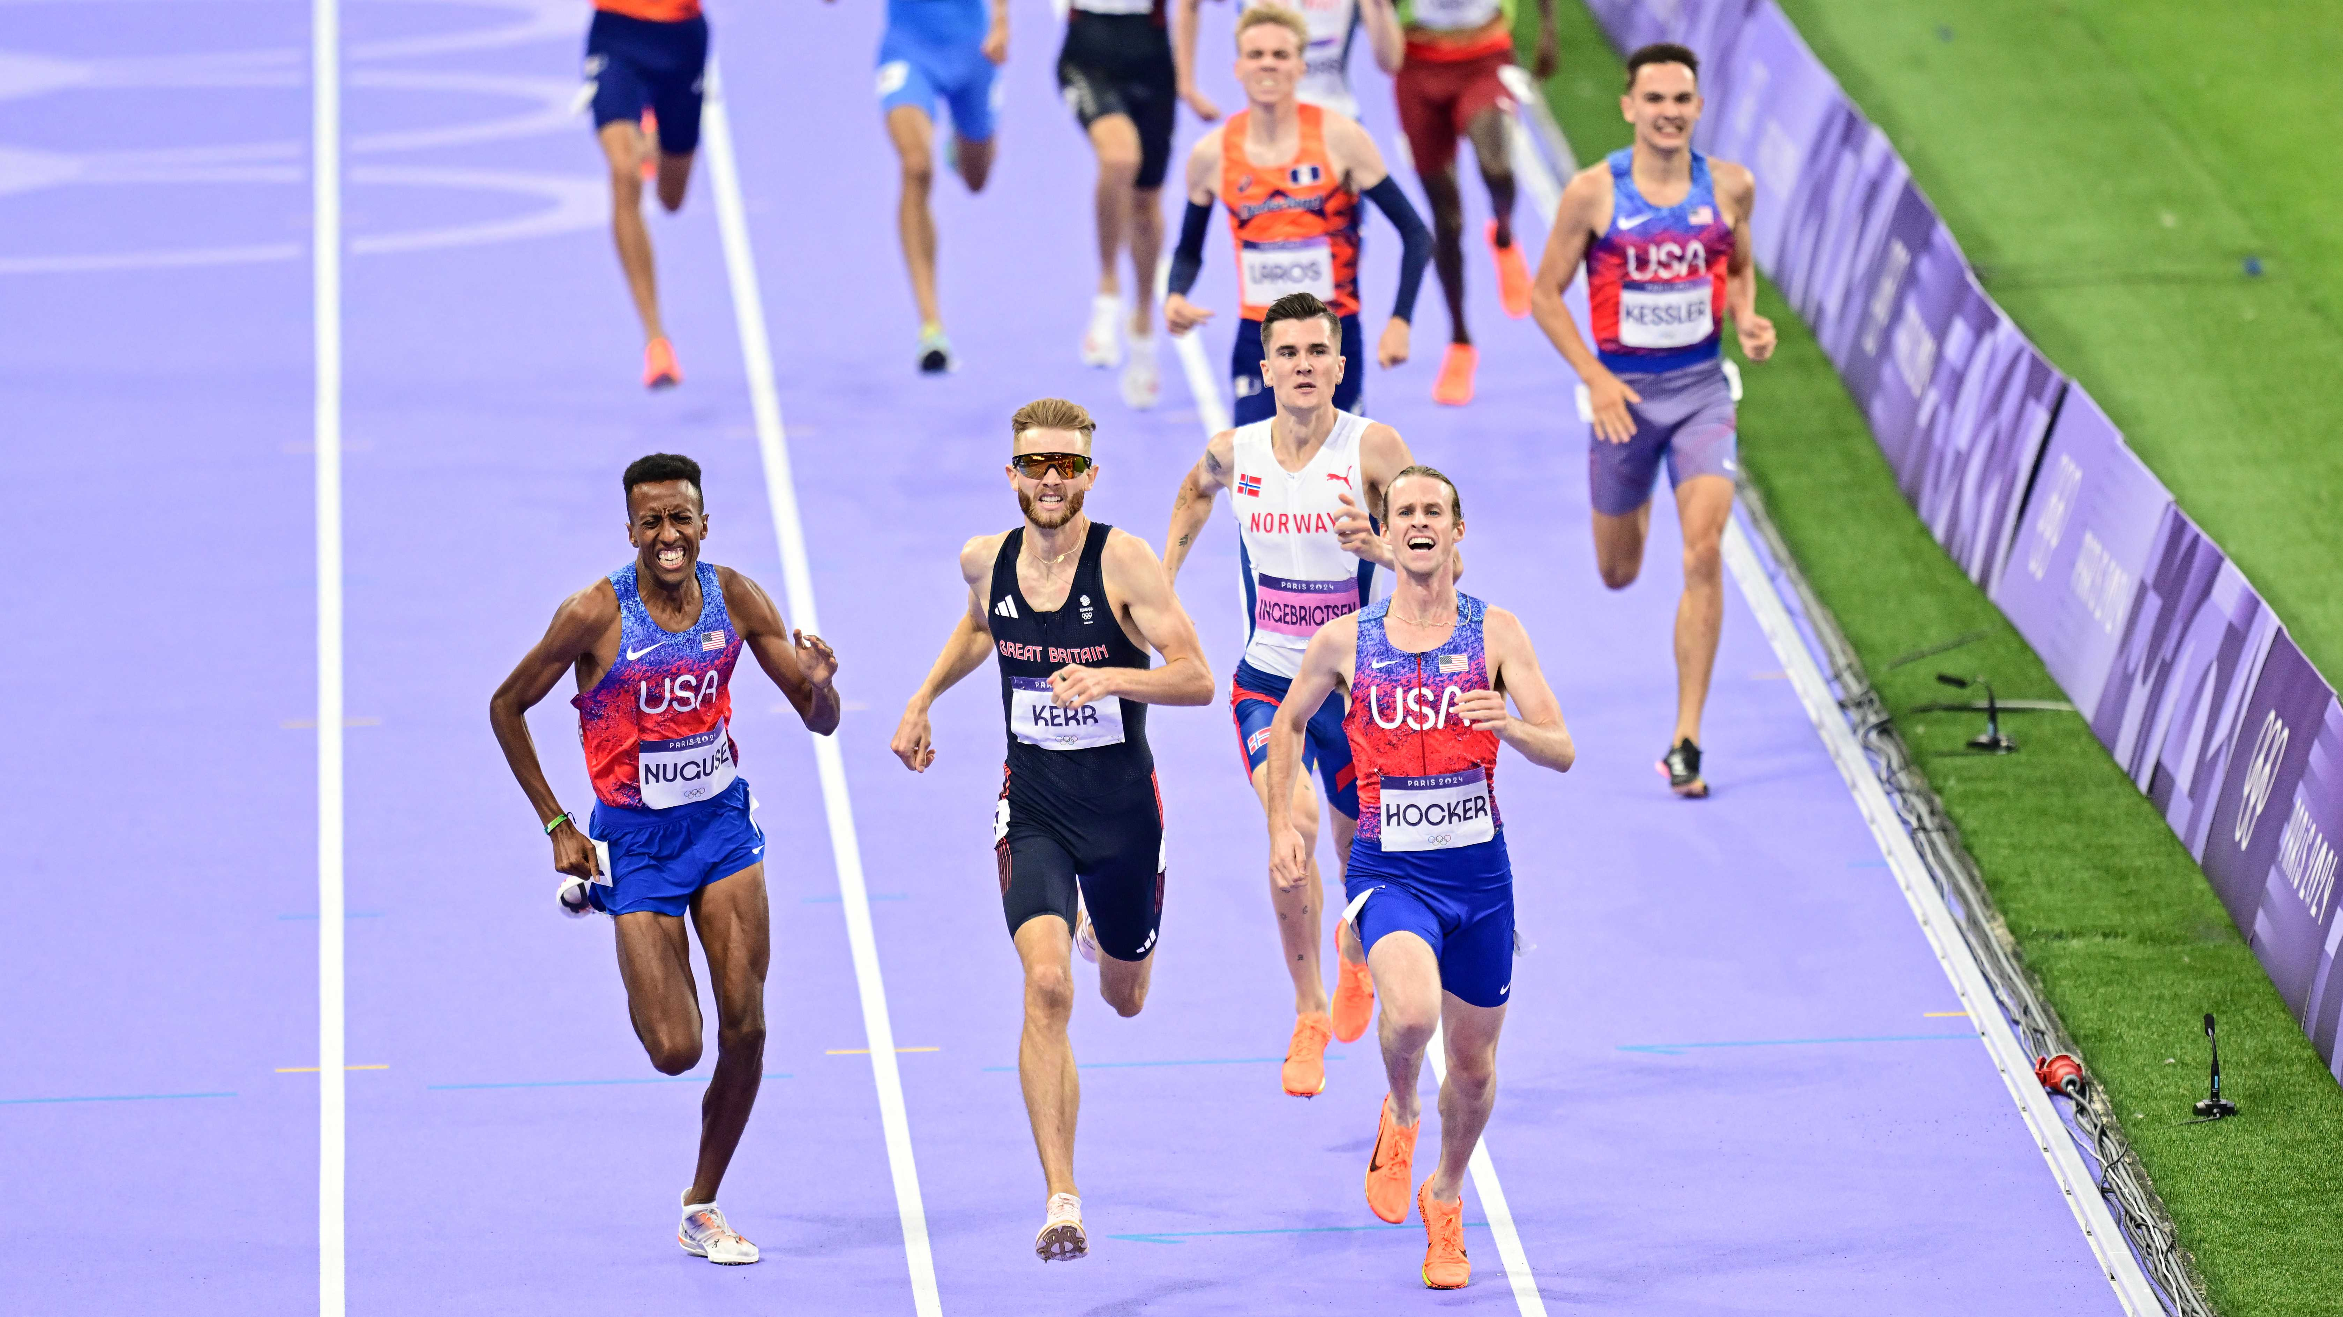
The Heart AS a
Model
Having a model of the heart is clearly useful for replacement purposes.
But, suppose we had a generalized model of the heart, dependent on a number of important factors: age, diet, family medical history
One could generate predictions for performance on novel “tasks”
Cole Hocker, 1500m, Paris, 2024
Notes:
Assume this guy is going through some midlife crisis. In addition to buying a ferrari, he’s decided he wants to run a marathon. So he goes to the doctor to ask if this is possible. How would a doctor make such a decision?

Slide 5

Other uses…
Climate change
Invasive species
Bacterial interactions
http://www.freeworldgroup.com/games9/gameindex/bacteriasimulator2.htm
The mind!
Drew Purves
Notes:
Matt botvinick also got poached away from Princeton for Deep Mind
So let’s talk about the brain. Seems like an ambitious endeavor, right? Well I guess 100 years or so ago it seemed that way for models of the heart as well.
So maybe we can learn how to model the brain by focusing on a set of very simple tasks to produce mechanisms that resemble neural function.

Slide 6
Key Concepts
Connect Parameters to Data
(Likelihood)
Incorporate Beliefs from Before the Data (Bayesian)
Model,
model parameters

Slide 7
Approaches to Statistics
Frequentists: From Neymann/Pearson/Wald setup. An orthodox view that sampling is inﬁnite and decision rules can be sharp.
Bayesians: From Bayes/Laplace/de Finetti tradition. Unknown quantities are treated probabilistically and the state of the world can always be updated.
Likelihoodists: From Fisher. Single sample inference based on maximizing the likelihood function and relying on the Birnbaum (1962) Theorem.

Slide 8
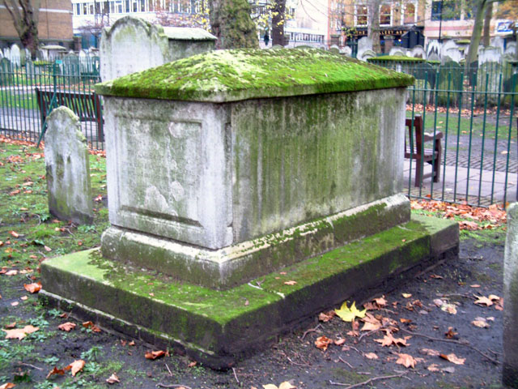
Influential People and Points in time
Reverend Thomas Bayes
Pierre Simon Laplace
Pearson, Fisher, Neyman, Wald
Jeffreys, de Finetti, Good, Savage, Lindley
Metropolis algorithm
A world divided (over practicality)
Gelfand and Smith (1990)
Today…

Slide 9
Terminology
Data: a random sample from an unknown population distribution. In our terms, they are the result of an experiment
Probability density function (PDF): a function that defines the density or probability of a given sample in the sample space. In our terms, this is the equation that formally describes the model
Parameter: the mechanism that defines the shape of the PDF.
Likelihood: value that specifies for a given parameter, how likely we are to have observed the data we observed

Slide 10

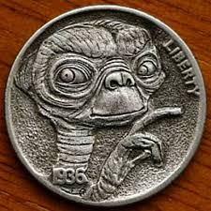
Example: Alien coins
Suppose our data are the result of a coin flipping experiment
Suppose this is an alien coin with some magnetic properties on one side that distorts the probability of observing a particular side (i.e., heads or tails) away from 0.5
Your goal is to estimate the probability of observing a “head” outcome given a fixed set of coin flips
Notes:
Unobtainium from avatar

Slide 11
Binomial Distribution
The data consist of a vector of “heads” and “tails”
Recode these to be a set of 1s and 0s (arbitrary)
{1,1,0,1,1,1,0,1,1,1}
One good model for describing the distribution of the number of heads (or 1s) is the binomial distribution
The parameter p describes the “single-trial” success probability of each coin flip.
The variable x describes the data (the number of heads), and n is the number of trials (i.e., flips)
$$f\left(x | p\right)=\frac{n!}{\left(n−x\right)!x!}p^{x}{(1−p)}^{n−x}$$
Notes:
X is the sum of the data vector in the line above.

Slide 12
Binomial Distribution
Key R operations for the binomial distribution:
rbinom: a function for randomly generating data from a hypothetical experiment
  Things you need:
  n: number of random samples in the experiment
  size: number of trials
  prob: this is the parameter p
dbinom: function for evaluating the PDF
$$f\left(x | p\right)=\frac{n!}{\left(n−x\right)!x!}p^{x}{(1−p)}^{n−x}$$
Open up “binomial.R”

Slide 13
Estimating parameters
But, in the real world, we get data, and we have no knowledge of what parameter generated the data
So how do we reverse this process to infer the model parameter from the data?
Suppose we flip the coin 10 times and get 8 heads:
{1,1,0,1,1,1,0,1,1,1}
What are some good estimates for p? How good are they?
Can we express the quality of the estimate across all values of p?
Notes:
Process called inference
Sometimes referred to as the inverse problem

Slide 14
Defining the Likelihood
We need a way to evaluate how ‘likely’ each value of p is relative to other values of p, given a set of data
A function, call the likelihood function, directly connects the probability parameter p to any set of hypothetical data
With this function, we need only find the value of p that maximizes this function
Open up “binomial.R”

Slide 15
PDF vs. Likelihood
PDF
Likelihood
Function of x, the data), given p
Probability measure
Units are really useful
Function of p, the parameter, given x
Un-normalized probability
Units are meaningless

Slide 16
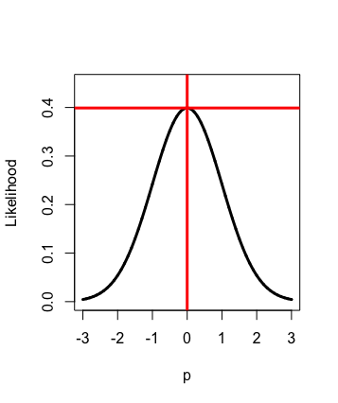
Analytic MLE
To maximize the likelihood, we want the point p that obtains the highest value on the y-axis.
Solve this equation involving partial derivatives with respect to the parameters p:

Slide 17
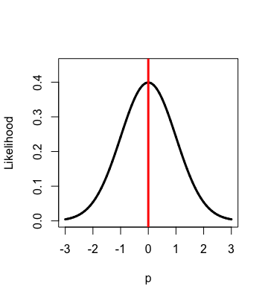
Numerical MLE
Another approach would be to use a “hill climbing” algorithm to locate the largest likelihood algorithm across all p
Initialize a value for
For t>1, draw a new value
Test whether
Open up “binomial.R”

Slide 18
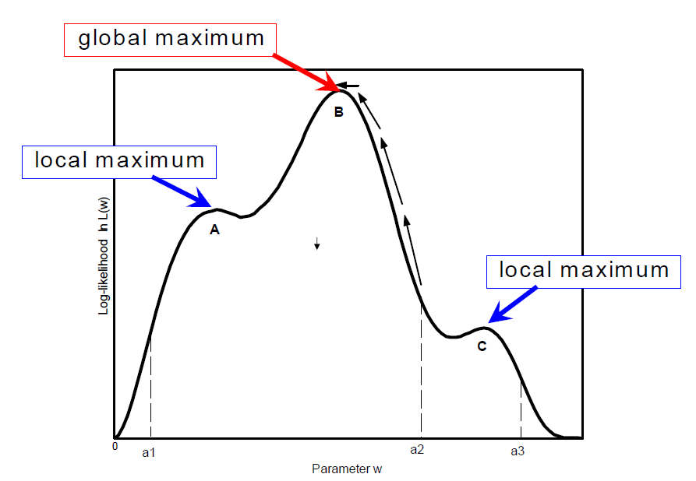
Local Maxima Problem

Slide 19
Local Maxima Problem
Sometimes several “optimal” values can be found
No optimization routine can guarantee that the MLE will always be found.
One solution is to run the routine many times, with different starting values
Perhaps the best solution is to use optimization techniques that use collective information, such as differential evolution or particle swarm
Turner, B. M., and Sederberg, P. B. (2012). Approximate Bayesian computation with differential evolution. Journal of Mathematical Psychology. 56, 375-385.

Slide 20

Ex-Gaussian Distribution
The ex‐Gaussian function is the convolution of two additive processes, a Gaussian (normal) function and an exponential function.
mu: mean of the Gaussian process
sigma: standard deviation of the Gaussian process
tau: the rate parameter of the exponential process

Slide 21
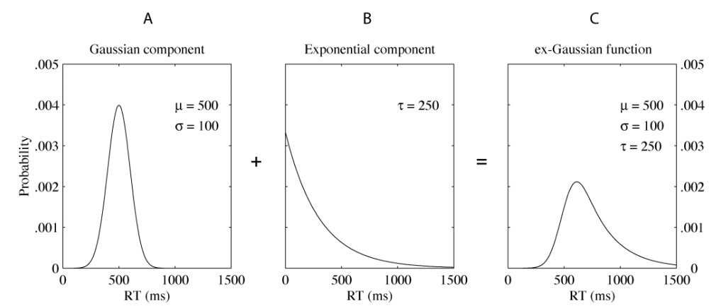
Ex-Gaussian Distribution
Open up “exGauss.R”
Luce (1986, chap. 6) describes the ex‐Gaussian as a decision time model in cognitive processes.
Van Zandt (2000, 2002), and Matzke & Wagenmakers (2009) also have good papers using the ex-Gaussian

Slide 22
SBI Summer School:
Bayesian Statistics

Slide 23
Bayesian Probability
The Bayesian perspective relies on a subjective interpretation of probability
The probability represents an individual’s degree of belief that an event will occur, whereas frequentist probability relies on the long-run averaged proportion
This subjectivity is one of the biggest criticisms of the Bayesian approach
But it is also one of the biggest strengths!

Slide 24

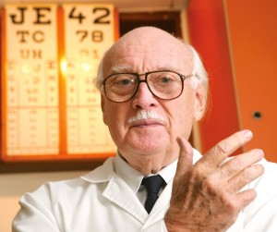

Bayesian Probability
  As such, Bayesian probability can be defined and meaningfully interpreted for non-repeatable one-time events, as well as for repeatable events, unlike the frequentist interpretation of probability.

Slide 25
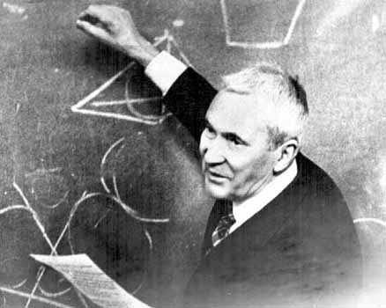
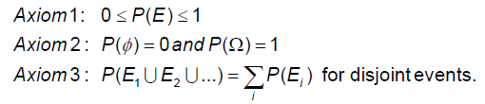
Bayesian Probability
  Both Bayesian probability and frequentist probability are mathematically well-defined, satisfying the Kolmogolov axioms of probability theory:

Slide 26
Bayes Rule
This is the rule (due to Rev. Bayes in the 1700s) that Bayesian statisticians use to update Bayesian probability.
Conditional Nature of Inference
  From the Bayesian point of view, statistical inferences are always conditional, that is conditioned upon what you already know
  This knowledge takes the form of the prior
  "The same data can lead to different conclusions depending upon other available information." (Berry, 1996)

Slide 27
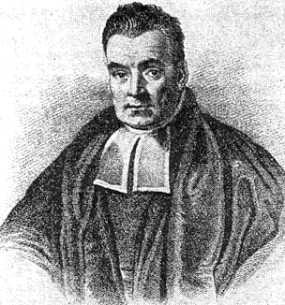
Bayes Rule (!)
unknown parameter
observation (data)
prior for the parameter
posterior probability of parameter after data
probability data given parameter (likelihood)
marginal distribution of the data

Slide 28
Bayes Rule (!)
unknown parameter
observation (data)
prior for the parameter
posterior probability of parameter after data
probability data given parameter (likelihood)
marginal distribution of the data

Slide 29
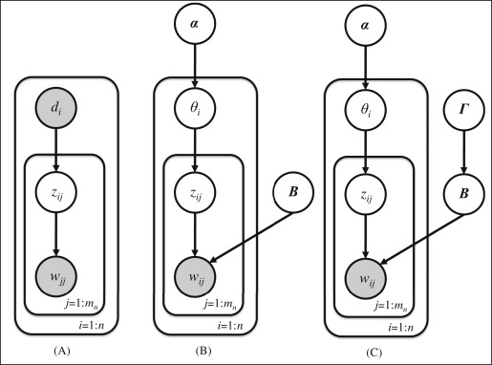
Hierarchies

Slide 30
A good Stopping Point For Day 1

Slide 31
Conjugate priors
A family of probability distributions is said to be conjugate if given that a prior is a member of a particular family, the posterior belongs to the same member
For the binomial model, the Beta prior is conjugate:
Prior:
Likelihood:
Posterior:

Slide 32

Cumulative Feature of Bayes
“Today’s posterior is tomorrow’s prior”
As the prior should reflect our belief about a process and unknown quantity (parameter), we should update our prior on the basis of the observed data
That means that in the next experiment, our new prior is informed by our old prior, as well as the data from Exp. 1

Slide 33
Example: Alien coins
Suppose our data are the result of a coin flipping experiment
Suppose this is an alien coin with some magnetic properties on one side that distorts the probability of observing a particular side (i.e., heads or tails) away from 0.5
Your goal is to estimate the probability of observing a “head” outcome given a fixed set of coin flips
Notes:
Unobtainium from avatar

Slide 34
Binomial Distribution
The data consist of a vector of “heads” and “tails”
Recode these to be a set of 1s and 0s (arbitrary)
{1,1,0,1,1,1,0,1,1,1}
One good model for describing the distribution of the number of heads (or 1s) is the binomial distribution
The parameter p describes the “single-trial” success probability of each coin flip.
The variable x describes the data (the number of heads), and n is the number of trials (i.e., flips)
$$f\left(x | p\right)=\frac{n!}{\left(n−x\right)!x!}p^{x}{(1−p)}^{n−x}$$

Slide 35
A prior for p
In a Bayesian setting, we must specify a prior for the parameter p.
In specifying the parameter, we must think about the support of p
Here, p is bounded by 0 and 1
A great choice for p is the flexible beta distribution

Slide 36
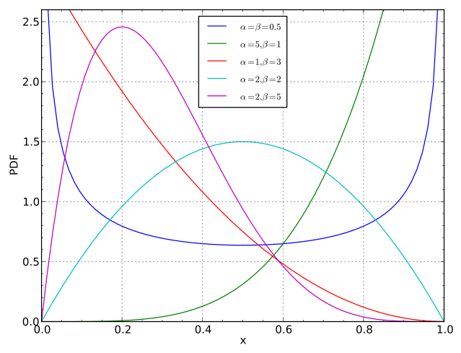

Open up “binomial_Bayes.R”

Slide 37
Approximating the Posterior
That integral in the denominator is tricky to evaluate for realistic problems
But it is still just a constant (that does not depend on the unknown parameter)
Open up “binomial_Bayes.R”

Slide 38
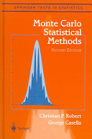
A World of Computation
Computational algorithms cracked countless problems
Research explosion 1990-now
Allowed solutions of practical and complex problems

Slide 39
Methods for Approximation
Gibbs Sampling (Gelfand and Smith, 1990)
MCMC (Robert and Casella, 2004)
Adaptive Rejection Sampling (Gilks & Wild, 1992)
DE-MCMC (ter Braak, 2006; Turner et al, 2013)
Variational Bayes (Bishop, 2006)
No-U-Turn (Hoffman & Gelman, 2011)

Slide 40
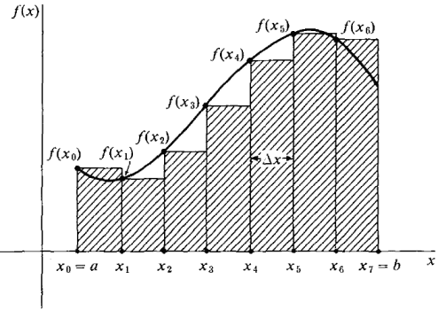
Method 1:
Numerical Integration
Carve up the space from a to b with bins of fixed or varying widths
Evaluate the value of the function at the location of the bins
Use the areas of the bins as an approximation of the area under the curve
Open up “binomial_Bayes.R”

Slide 41
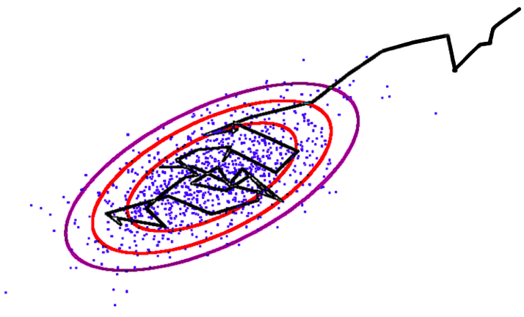
Method 2: Markov
Chain Monte Carlo
An algorithm for traversing the parameter space
Visits and revisits regions of the parameter space with frequency proportional to the density of the ‘target’ distribution
Relies on a transition kernel to guide the walking process

Slide 42
Method 2: Markov
Chain Monte Carlo
Initialize the “chain” by picking a value that will have nonzero density in the target distribution (i.e., the posterior)
x[1]=.5
For t in 2:N
  Sample x* from transition kernel: x*~q(x*|x[t-1])
  Evaluate x* density in the posterior
  Test whether x* has higher density than x[t-1]
  Accept x* with Metropolis-Hastings probability:

Slide 43
Likelihood complications?
unknown parameter
observation (data)
prior for the parameter
posterior probability of parameter after data
probability data given parameter (likelihood)
marginal distribution of the data

Slide 44
Likelihood complications
When the likelihood is difficult to evaluate, there are numerical methods for approximating it
They are based on the assumption that simulating the model for a given parameter is easy
The idea is simple: if a parameter produces simulated data that are similar to the observed data, then that parameter should be more likely in the posterior than others

Slide 45
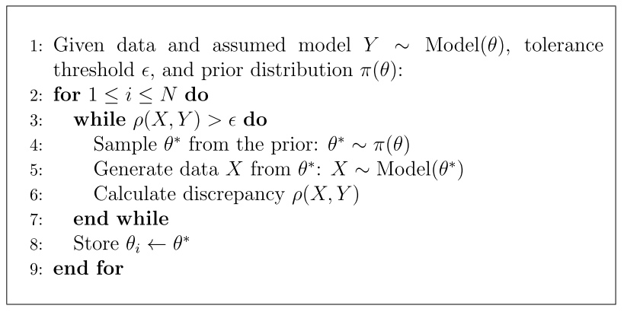
Strategy for estimating parameters
Turner, B. M., and Van Zandt, T. (2012). A tutorial on approximate Bayesian computation. Journal of Mathematical Psychology, 56, 69-85.

Slide 46
Strategy for estimating parameters
Pick some random value for p, call it p*
Perform an experiment via Binomial model with p=p*
  Call these data X*
Compare X* to X
  If X* and X are close, store p*
  If X* and X are not close, discard p*
Open up “binomial_Bayes_simulation.R”

Slide 47

An Example

Slide 48
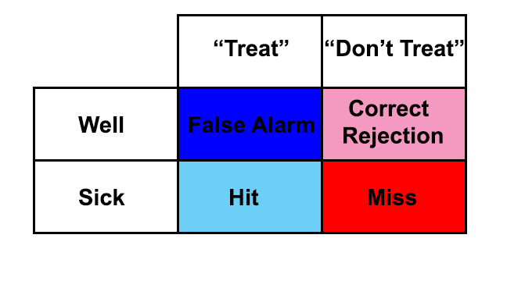

Slide 49
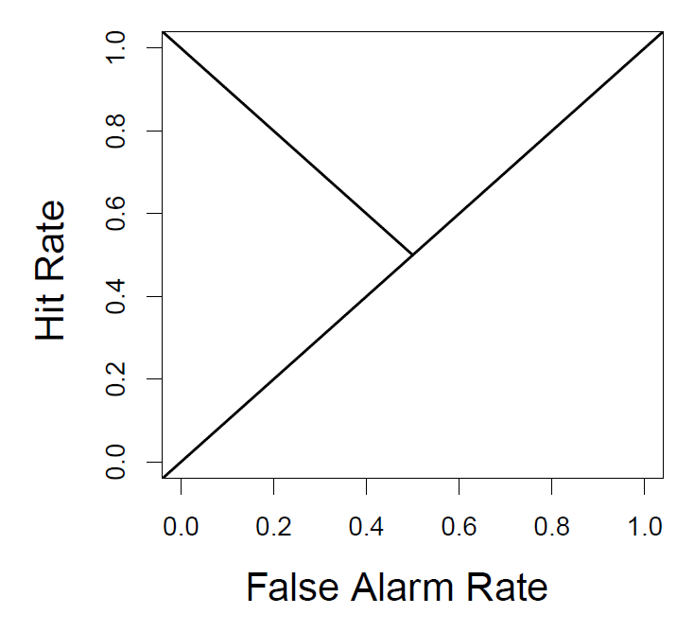

Slide 50
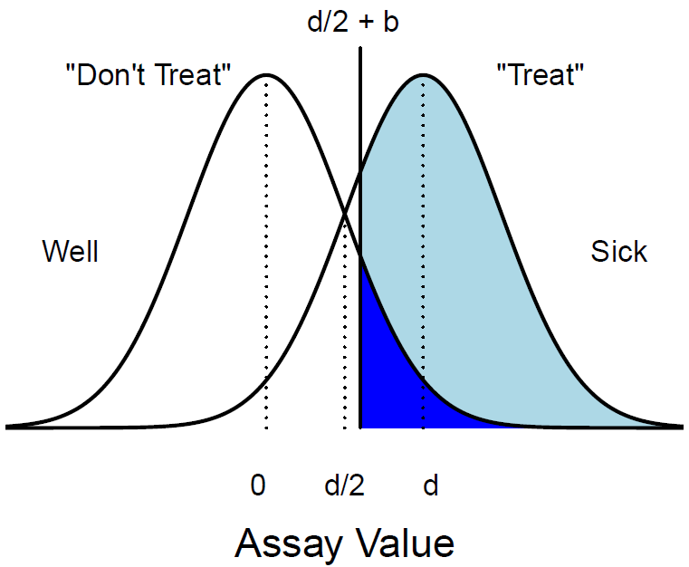
Signal Detection Theory

Slide 51
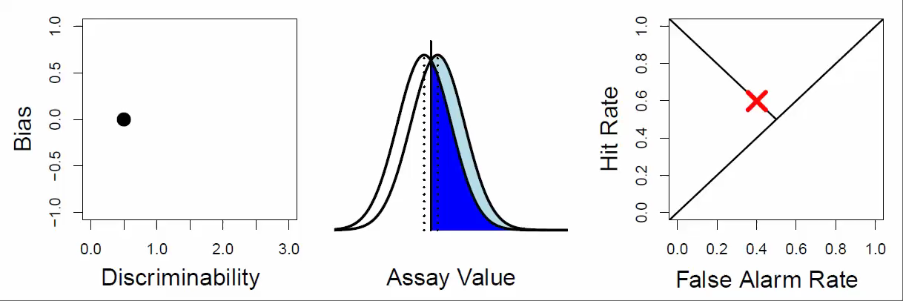
Connecting Theory to Data

Slide 52
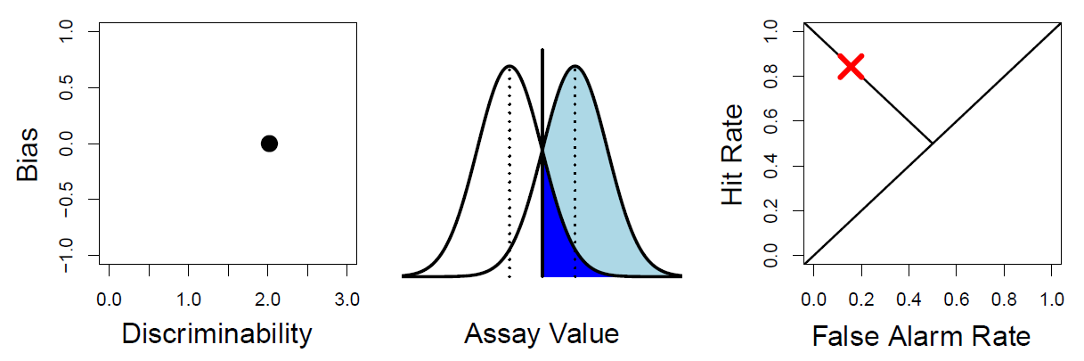
Connecting Theory to Data
Open up “sdt_simulation.R”

Slide 53
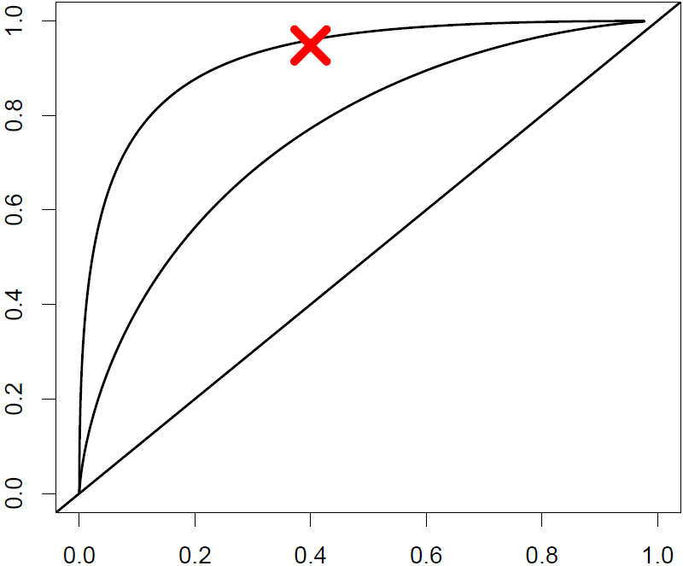
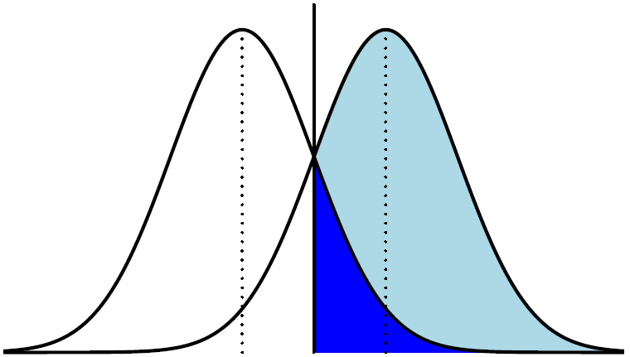
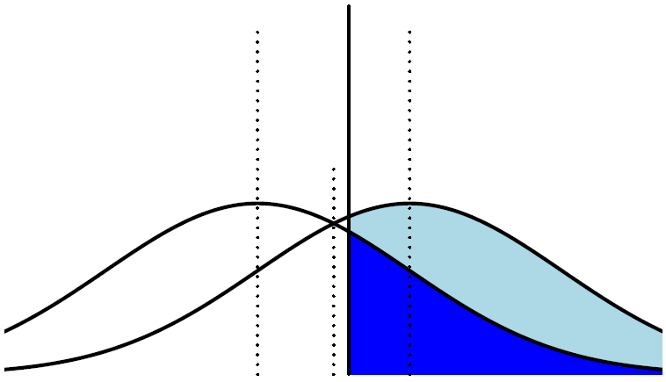
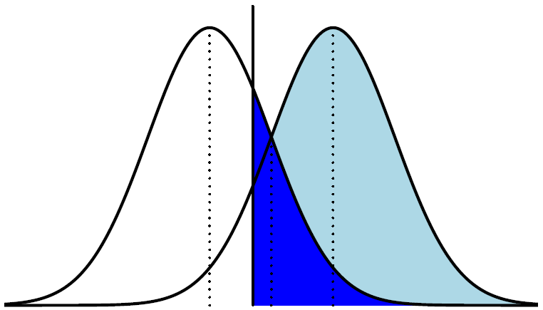
Strategy for estimating parameters
We could try
  Picking lots of values for (b,d)
  Looking at the mean and variability in the predictions
  Settle on values that most closely match our data

Slide 54
Strategy for estimating parameters
We could try
  Picking lots of values for (b,d)
  Looking at the mean and variability in the predictions
  Settle on values that most closely match our data
Notes:
Picking a distribution of acceptable values on the left enables us to cross off representations on the right.

Slide 55
Strategy for estimating parameters
Open up “sdt_simulation_inference.R”

Slide 56
SBI Summer School:
Model Fit

Slide 57
Model fit
“The purpose of models is not to fit the data, but to sharpen the questions.”
(from Cavagnaro et al., 2013)
Karlin, S. (1983). The 11th R. A. Fisher Memorial Lecture given at the Royal Society 20 Meeting in April, 1983.
Notes:
We know that ultimately, we want the model to fit data (that we have) well. But does this really give us evidence?

Slide 58
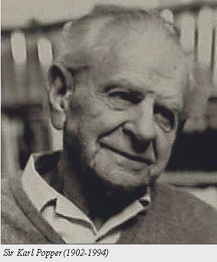
Philosophy of Science
First, we can test a prediction of the theory.
  Make an observation that might contradict the theory
  Test to see whether the theory can make such a prediction
Popper (1959) supported the notion that a theory must specify some possible observations that could falsify it, and a theory gains support by observations if the observations might have had outcomes inconsistent with the theory
  Concept of ‘falsifiability’
Notes:
Karl popper – the most influential philosopher of science – advocated ‘falsifiability’ as the essential feature of scientific inquiry.

Slide 59
Philosophy of Science
Second, if there are competing explanations (models) of observations, we can test a prediction of each competing theory
Often, alternative theories are incompatible with a set of observations
By systematically eliminating competing premises, one can gain support for one explanation over another
Notes:
Karl popper – the most influential philosopher of science – advocated ‘falsifiability’ as the essential feature of scientific inquiry.

Slide 60
Philosophy of Science
If alternative theories make different predictions, we can combine the two approaches and test both predictions at the same time
When they are incompatible, we can perform strong inference (Platt, 1964)
Roberts and Pashler argue that nothing about a good fit to data as an argument for a theory is supported by the philosophy of science
Notes:
Karl popper – the most influential philosopher of science – advocated ‘falsifiability’ as the essential feature of scientific inquiry.

Slide 61
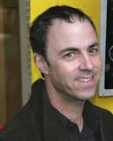
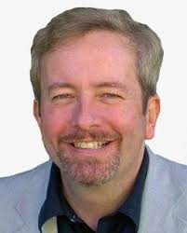
A Good Fit Reveals
Nothing About…
The flexibility of the theory (how much it cannot fit)
The variability of the data (how firmly the data rule out what the theory cannot fit)
The likelihood of other outcomes (perhaps the theory could have fit any plausible result)
A researcher needs all 3 pieces of information to decide how much the fit should increase belief in the theory
Seth Roberts
Hal Pashler

Slide 62
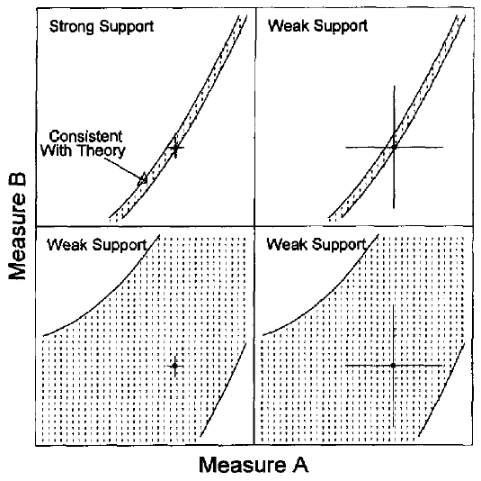
Variability and Flexibility
Low variability in data, low flexibility in model
High variability in data, low flexibility in model
Low variability in data, high flexibility in model
High variability in both data and model
Notes:
Data are plus signs

Slide 63

On the Defensive
Defense 1: A good fit is impressive when there are more observations in the data set than free parameters in the model
They argue that this is a very generous rule.
Model complexity, as we discuss later, it not as simple as calculating the number of free parameters
Functional form, correlations between parameters, etc.
Notes:
Some people argue that because a model is stochastic it is complex. This is not the case. Complexity should not involve your subjective experience of how difficult it is to work with the model.

Slide 64
On the Defensive
Defense 2: My model fits better than another model
If a model can capture more data than another model, it is often thought to be be “better”
It could just be that the winning model was more flexible
They argue comparing predictions of models is better than comparing model fits
  (note that this is before the development of many modern measures of model fit and complexity)

Slide 65
On the Defensive
Defense 3: The research and editorial processes protect readers from too flexible models
Many models might be rejected because they cannot fit the data, and so when submitting a paper, a sort of filtration process has already happened
They argue that there is no way to evaluate whether or not this is true, either from the reader or reviewer’s point of view

Slide 66
A better way to test a theory is to…
They state that the use of good fits as evidence is not supported by philosophers of science nor by the history of psychology
  “there seem to be no examples of a theory supported mainly by good fits that has led to demonstrable progress”
Determine how the theory constrains possible outcomes (i.e., what it predicts)
Assess how firmly actual outcomes agree with those constraints
Determine if plausible alternative outcomes would have been inconsistent with the theory
Notes:
A better way to test a theory with free parameters

Slide 67


When a good fit can be bad
Model development
Complexity vs. generalizability
Measures of generalizability
Simulation study
Jay Myung
Mark Pitt

Slide 68
Model development
In developing a cognitive model, we often start with a very specific theory
From the theory, we can imagine different instantiations of that theory, and these are called models
We wish to find the model that best captures the data
Theory
Model A
Model A1
Model A2
Model B
Model B1
Notes:
Sdt as a theory. It could have any type of distribution
SDT with Gaussian variables is a model. It makes specific assumptions, has equations and so on.
SDT with unequal variance is another type of model. But it can be viewed as a more general case of the first one.

Slide 69
Deciding Among models
One criterion in model development is that the model can reproduce data from observed experiments
So, it makes sense to compare models on the basis of model fit, with the logic being “the model that maximizes model fit, wins”
The model that provides the closest fit to data must be the model that best approximates the cognitive process
Notes:
(Last point)
This is different from Roberts and Paschler.
They are saying this in the context of penalizing for complexity

Slide 70
One measure of “close”
There are many ways of assessing how close a model’s predictions are to the observed data
One really popular method is the “root mean squared error”:
X: predictions from a model
Y: observed data (or statistics of data)
Note that the sum happens after the squaring!
Notes:
Show a plot of a decaying function with points jumbled around the main prediction. Explain how you would calculate the RMSE

Slide 71
Noisy data
The proceeding logic makes perfect sense, but only in a completely “noiseless” environment
Yet, error arises from many sources in an experiment
  Imprecision of our measurement tools
  Variation in participants
  Variation in performance over time
Noise makes GOF measures poor indicators of model fit, as they are insensitive to different sources of variation
Notes:
GOF: goodness of fit

Slide 72
Generalizability
One method of obtaining a sense of the plausibility of a model is through generalizability
Generalizability: the ability of a model to fit all data samples generated by the same cognitive process, not just the currently observed sample
In this framework, model fit to data is a necessary but not sufficient condition
  Lots of models can fit data, but can they make good predictions to new data?

Slide 73
Measures of generalizability
By design, all measures of generalizability must take into account a GOF metric
Beyond GOF, measures of generalizability try to apply penalization terms on the basis of the model’s architecture
These terms level the playing field among models so that one model, by virtue of its design choices does not have an inherent advantage over its competitors in fitting the data best, and thus being selected.

Slide 74
Complexity
Complexity: the property of a model that enables it to fit diverse patterns of data; it is the flexibility of a model.
A more complex model can fit more patterns of data, whereas a simpler model is less capable
How do we measure complexity?
Number of free parameters in a model
The functional form (i.e., equations in the model)
Number of distinct PDFs that the model can generate
Notes:
Mention that this is not the same as computational complexity or difficulty of implementation

Slide 75
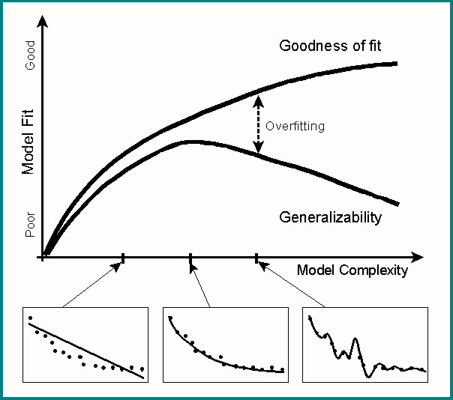
The role of model complexity
As a model becomes more complex, it
Fits the data better
Becomes less generalizable
Is less interpretable
Potentially less useful?
Notes:
What goes up must come down
Verbal interpretation of ‘rolle’s theorem’

Slide 76
Number of Parameters
Early measures of generalizability accounted for the most salient factor in complexity: the number of free parameters
k: number of free parameters
n: number of trials in the data
L(θ): log likelihood obtained (at best fitting parameters)
Akaike information criterion (AIC)
Bayesian information criterion (BIC)
Notes:
Lowest value of BIC is preferred

Slide 77
Functional Form
Another class of generalization methods examines a model’s functional form
p(y|θ): likelihood function
I(θ): Fisher information matrix
Bayesian model selection (BMS):
Minimum description length (MDL):
Notes:
Got to here.

Slide 78
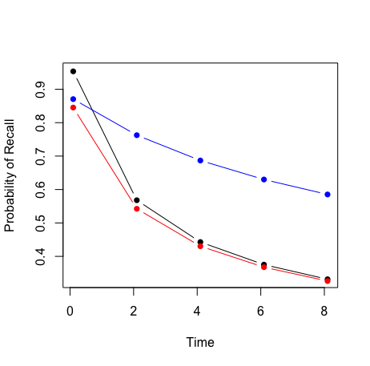



Simulation study
Let’s do a simulation study to gain some insight into how flexibility and model fit trade off with one another.
Consider three different models of memory ability with increasing levels of complexity:
M1: Black
M2: Red
M3: Blue
$${f\left(t | a\right)=(1+t)}^{−a}$$
$${f\left(t | a,b\right)=(b+t)}^{−a}$$
$${f\left(t | a,b,c\right)=(b+ct)}^{−a}$$

Slide 79
Simulation study
The procedure is simple (but the code is a little complex):
  Generate data from some model i
  Fit Models 1 through M to the generated data
  Assess which of the M models fit best
  Repeat for a different Model j until all M models
Repeat many times…
Open up “model_recovery.R”

Slide 80
Cross Validation
The epitome of assessing generalization is through cross validation, where a model is fit to some partition of the data, then used to predict withheld data from the same experiment
Sub | Trial 1 | T2 | T3 | T4 | T5 | T6 | T7 | T8 | T9
1
2
3
4
5

Slide 81
Cross Validation
The epitome of assessing generalization is through cross validation, where a model is fit to some partition of the data, then used to predict withheld data from the same experiment
Sub | Trial 1 | T2 | T3 | T4 | T5 | T6 | T7 | T8 | T9
1
2
3
4
5

Slide 82
Leave one out
Cross Validation
You can also loop through subject by subject, or even trial by trial, fit the data to the observed partition, make predictions about the withheld partition, and evaluate
Sub | Trial 1 | T2 | T3 | T4 | T5 | T6 | T7 | T8 | T9
1
2
3
4
5

Slide 83
Leave one out
Cross Validation
You can also loop through subject by subject, or even trial by trial, fit the data to the observed partition, make predictions about the withheld partition, and evaluate
Sub | Trial 1 | T2 | T3 | T4 | T5 | T6 | T7 | T8 | T9
1
2
3
4
5

Slide 84
Leave one out
Cross Validation
You can also loop through subject by subject, or even trial by trial, fit the data to the observed partition, make predictions about the withheld partition, and evaluate
Sub | Trial 1 | T2 | T3 | T4 | T5 | T6 | T7 | T8 | T9
1
2
3
4
5
Open up “model_cross_validation.R”

